Slide 1
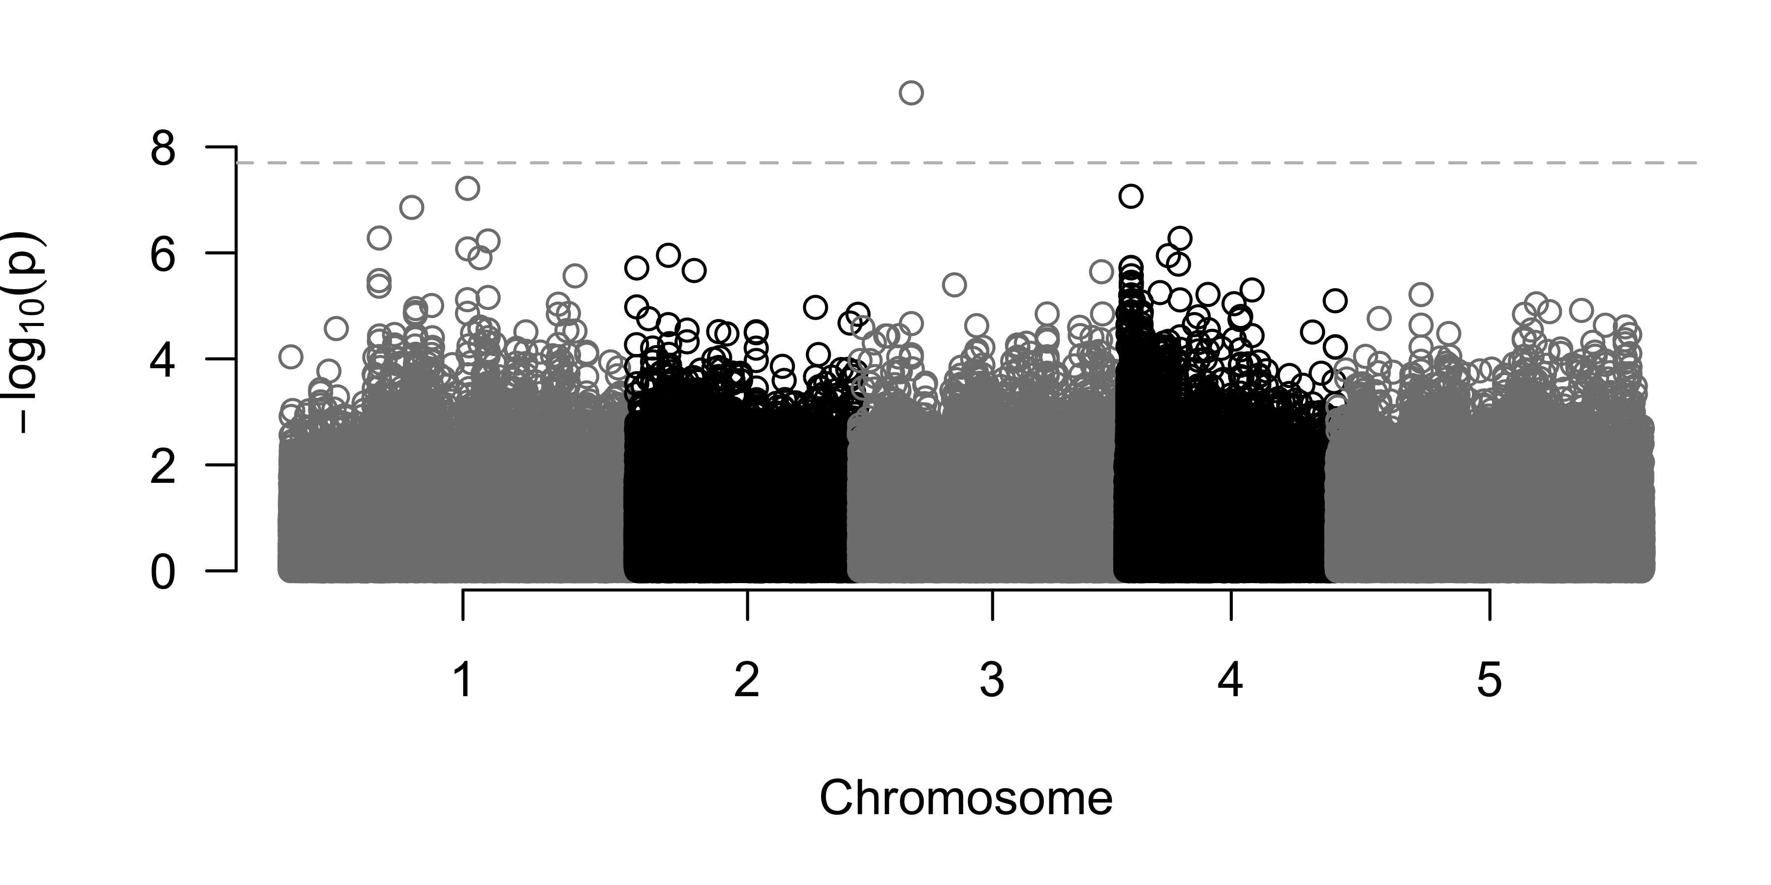
A
MYB26
EPFL3
AT3G13880.1
AT3G13890.1
AT3G13898.1
AT3G13900.1
AT3G13882.1
AT3G13890.2
AT3G13882.2
putative ribosomal gene
4574114 4579943 4585773
4579292
B

Slide 2
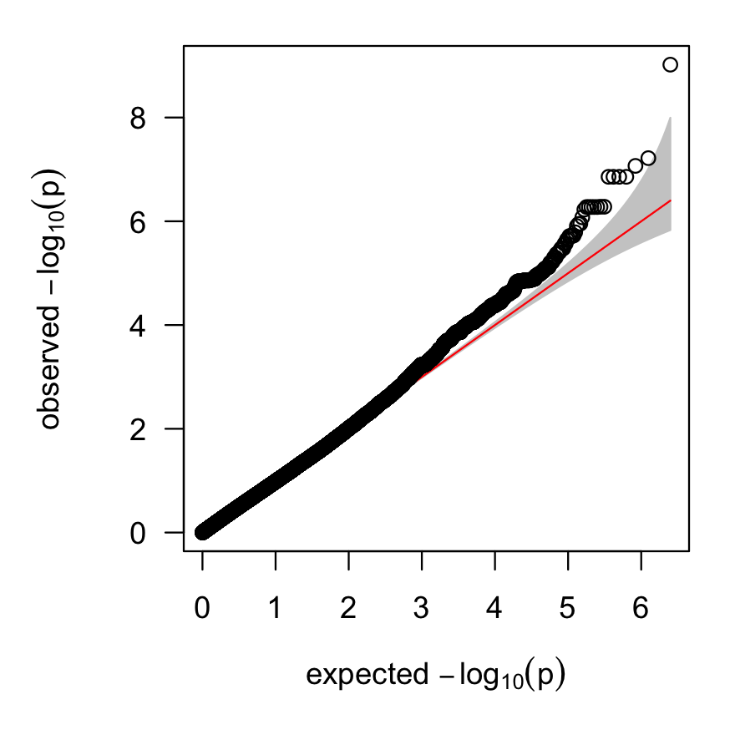
A
OTP72
MYB26
AT3G13860.1
RHD3
AT3G13880.1
AT3G13890.1
AT3G13898.1
AT3G13900.1
AT3G13870.1
AT3G13882.1
AT3G13890.2
AT3G13900.2
AT3G13870.2
AT3G13882.2
AT3G13900.3
AT3G13910.1
AT3G13910.2
4562454 4568284 4574114 4579943 4585773
B
4579292
C

Slide 3
